Slide 1
Information Technology Infrastructure
IT Infrastructure consists of the categories
Chapter 2 – Computer Hardware
Chapter 3 – Computer Software
Chapter 5 – Networking and Data Communication

Slide 2
Chapter 2 – Computer Hardware
Computer hardware encompasses digital devices that can be physically touched

Slide 3
Digital Device = Binary Processor
Digital data is represented and manipulated using the binary system = Base 2
Each digit in binary is called a bit
A bit value can is in one of two states
Represented by 0/1, T/F, On/Off. 0 1
A group of 8 bits is called a byte see below
Decimal number = 74
ASCII letter = 'J'
Gray Level = 28.9%
A group of 16 bits is called 2 bytes see below
0011,0000,0100,0010 = 12354 decimal = あ unicode
0101,1100,0111,0001 = 23665 decimal = 山 unicode
0
1
0
0
1
0
1
0

Slide 4
Personal Computers
Personal Computers support a person
Desktop computer = Designed so all of the components fit entirely on or under a desk or table
Laptop (Notebook) computer = Portable computer
Tablet (e-Reader) computer = iPad, Kindle
Smart phones = iPhone, Android
Notes:
4

Slide 5
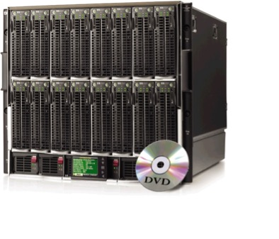
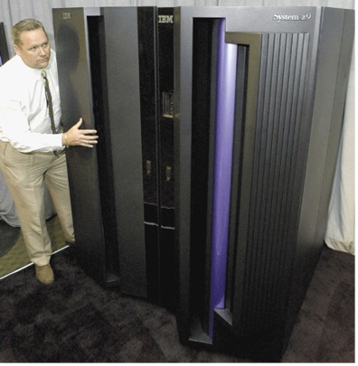
Server Computers
These computers are shared by many users
Servers control access to network resources and provides centralized storage
Web Servers serve web applications and web pages for World Wide Web using Internet
Mainframe Powerful, expensive computer that supports thousands of connected users
Supercomputer Fastest, most powerful, most expensive computer used for applications requiring complex mathematics

Slide 6
Embedded Computers
An embedded computer is a special-purpose computer that functions as a component in a product

Slide 7
Memory Size and Speed
Storage memory capacity is expressed in the number of bytes
1 KiloByte = 2¹⁰ or 1024 bytes
1 MegaByte = 2²⁰ or 1,048,576 bytes
1 GigaByte = 2³⁰ or 1,073,741,824 bytes
1 TeraByte = 2⁴⁰ or 1,099,511,627,776 bytes
Bus speeds
1 KiloHertz = 10³ or 1 milliSecond
1 MegaHertz = 10⁶ or 1 microSecond
1 GigaHertz = 10⁹ or 1 nanoSecond

Slide 8
Inside the Case of a Desktop Computer
Motherboard provides electrical interconnects
CPU = microprocessor
Storage devices: Hard drive, SSD, CD/DVD Drive
Memory
Ports
Slots

Slide 9
Central Processor Unit and Memory
CPU
Register memory (fastest)
Data transferred with memory via three buses
RAM Memory
Random-access memory
Volatile memory
Stores program instructions and data
ROM Memory
Read-only memory
Non-volatile memory
Boot program
Usually Flash memory
Speed CPU→RAM→SSD→HD
Memory 4 GBytes
800 MHz = 1.25 nSec
Address Bus
Control Bus
Data Bus
CPU
8 KBytes Registers 4 GHz = 250 pSec

Slide 10
Storage devices are Non-volatile
Storage devices
hold data, information and instructions for future use
Storage media is physical material used for storage
Magnetic: Hard drives, diskettes, credit cards, tapes
Optical: removable media
CD, CD-R, CD-RW = 700 MB
DVD = 4.7 GB
Blue Ray Disk = 25 GB
Solid State Devices:
USB Drives
SSD Drives
Flash memory

Slide 11
Input and Output Peripheral Devices
Computer’s perspective determines whether Input (data) or Output (information) devices
Input devices: keyboard, mouse, microphone, camera, scanner, joystick, remote control
Output devices: display monitor, printer, speakers
Touch screens
Provide both input and output
Ports connect peripherals
USB 2 or 3 Ports
HDMI ports for Video
Bluetooth is actually a wireless radio signal port

Slide 12
Chapter 3 – Software
Software, tells computer the tasks to perform and defines a sequence to execute the tasks
Operating System
Delivers hardware resources to user
User interface to application software
Provides Graphical User Interface
Windows, MacOS, Linux, iOS, Android
Applications Software
Word Processing = Microsoft Word
Spreadsheets = Excel
Presentation Graphics = PowerPoint
Database = Access
Office Suites: Microsoft Office, LibreOffice
Cloud based software: Google docs, zoho.com

Slide 13
Functions of an Operating System
Interfacing with Users
Booting the Computer
Loads essential part of OS into memory
Determines hardware connected
Configures peripheral devices
Device driver software for hardware communication
Plug and Play devices are recognized by OS
Provides a platform to write applications
Managing Network Connections
Manages wired connections to network
Manages wireless connections Wifi, 3G, etc.
File Management - Windows Explorer, MacOS finder
Files usually viewed in hierarchical folder (directory) structure
Security: Passwords andFirewalls

Slide 14
Unix and Linux
UNIX: AT&T and Sun Microsystems
Intended for workstations and servers
Linux
Developed by Linus Torvalds in 1991 grad project
Open-source software: usually free without support
http://distrowatch.com/
My favorites are: Zorin, Ubuntu Mate, Mint
Very powerful with bash scripting
Strong support from mainstream companies
Google, Oracle, IBM, HP, and Novell
Android OS is a derivative of Linux
MacOS is a derivative of UNIX

Slide 15
Utility Programs
Software that is usually related to managing or maintaining the computer
Many utilities are built into operating systems
Control Panel accesses common utilities
File management program = Windows Explorer
Search Tools = integrated into Windows Explorer
Diagnostic and Disk Management Programs
Uninstall and Cleanup Utilities
File compression programs = Windows Explorer or 7-zip
Backup and Recovery Utilities
Can be stand-alone products
Antivirus Scanner = BitDefender, AVG and Avast
Spyware Scanner = Spybot Search and Destroy

Slide 16
Application Software
How is software distributed?
Commercial software, mass-produced for purchase
Microsoft Office
Custom software, performs functions specific to a business or industry
Web app software, hosted by a Web site
Google Drive, Zoho, and Microsoft Office 365
Open source software, provided for use, modification, and redistribution
www.OpenOffice.org www.LibreOffice.org
Shareware, copyrighted software that is distributed free for trial period
Freeware, copyrighted software provided at no cost
Public-domain software, freeware with no copyright restrictions
Notes:
Slide Set 3: SoftwareIFSM201: Slide Set 3: Software
Copyright © 2010 R.M. LaurieCopyright © 2010 R.M. Laurie
16

Slide 17
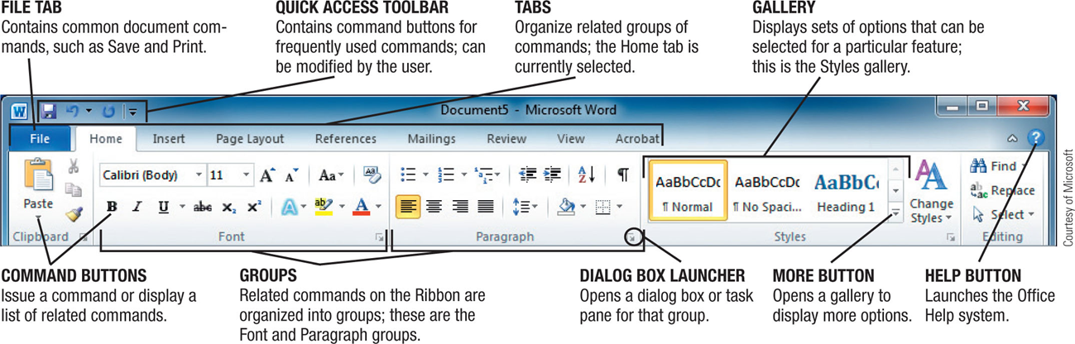
Office Suite Software
Programs designed to make users more productive and assist them with tasks
Microsoft Office = packaged software
Core applications: Word, Excel, PowerPoint, Access
Personal Information Manager – Outlook
Notes:
Slide Set 3: SoftwareIFSM201: Slide Set 3: Software
Copyright © 2010 R.M. LaurieCopyright © 2010 R.M. Laurie
17
IFSM201: Slide Set 3: Software
Copyright © 2010 R.M. Laurie
17
The difference between operating systems and application software needs to be discussed. Key terms and ideas include:
Operating System - the software that controls the execution of all applications and system software programs.
Word Processing - software used to enter, store, manipulate, and print text.
Spreadsheets - software that permits users to work with rows and columns of data.
Databases - software used for record-keeping.
Presentation - software that allows users to create visually appealing presentational graphics and information.
Antivirus -a program that can automatically detect a virus when one appears on the computer system.

Slide 18
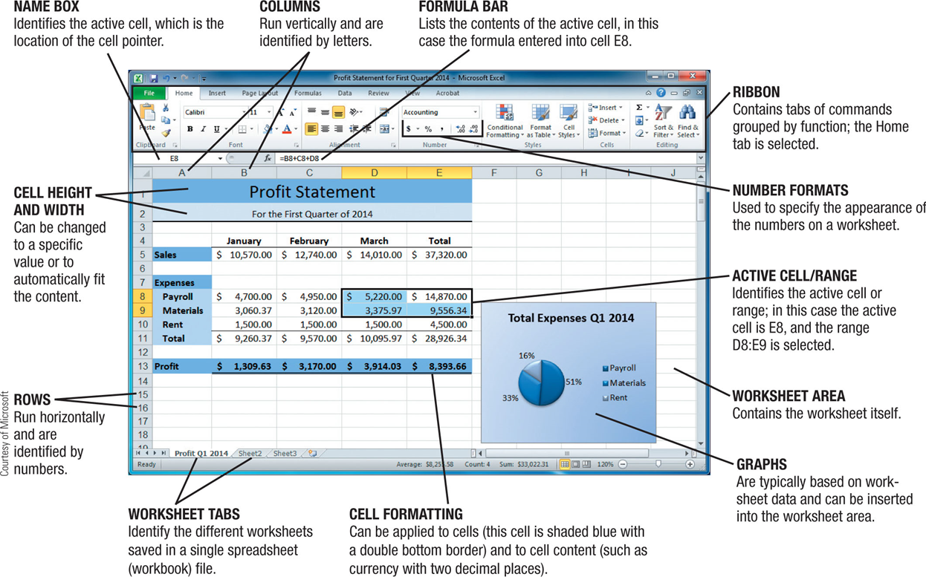
Spreadsheet
Spreadsheet software allows users to organize data, perform calculations, and chart data as graphic
Notes:
Slide Set 3: SoftwareIFSM201: Slide Set 3: Software
Copyright © 2010 R.M. LaurieCopyright © 2010 R.M. Laurie
18
IFSM201: Slide Set 3: Software
Copyright © 2010 R.M. Laurie
18
18

Slide 19
Applications for the Enterprise
Enterprise Resource Planning (ERP)
ERP is software applications that utilize a central database for the entire organization
Enforce best practices
Supply Chain Management (SCM) module included
Can take 2 – 3 years to implement and lots of $$$
Supply Chain Management (SCM)
Inventory control, supplier links, distributor links
Customer Relations Management (CRM)
Create relationships with customers
Salesforce is the current leader
UMUC chose Salesforce

Slide 20
Chapter 5 – Networking
A Network is a collection of computers and devices connected together via transmission media
Ethernet is standard protocol used for LAN=Local Area Network (Wired)
Wi-Fi is a wireless LAN using radio
Mobile Networks: 3G, 4G, WiMax
Internet is a worldwide collection of interconnecting networks that connects millions of worldwide
Intranet is only accessible within corporate networks
Extranet connects with suppliers, partners, and customers
Notes:
20

Slide 21
TCP/IP Internetworking Protocols
Client contacts server specified by URL =Uniform Resource Locator
Client Computers
HTTP
TCP
IP
Server Computers
HTTP, TCP, IP
Router IP
The Internet Infrastructure
Router IP
Router IP
Local
Area
Network
IP = Internet Protocol
Provides end to end communication
TCP = Transmission Control Protocol
Provides reliable data transport
HTTP = Hyper-Text Transfer Protocol
Provides Application Facilities
How the Internet Works = http://youtu.be/7_LPdttKXPc
Notes:
12

Slide 22
Accessing the World Wide Web
The World Wide Web utilizes the Internet
HTTP (Hyper Text Transfer Protocol) accesses web sites files located on the web server
Each web site has URL (Uniform Resource Locator)
http://www.islandman.org
http://www.umuc.edu
http://mail.yahoo.com
http://www.umuc.edu/cs/courses/index.html
Domain Name Server matches URL with IP address
www.nmcnet.edu → 12.178.198.111 ( Octet <= 255)
www.whois.ws → 69.25.212.161
.edu (education)
.com (commercial)
.gov (government)
.org (non-profit)
Protocol Server Domain TLD Folder Path File
Notes:
12

Slide 23
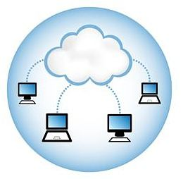
Cloud Storage
Cloud storage refers to the creation and use of remote servers over Internet for data storage
Can share files across multiple Devices
Free Services: Dropbox, Google Drive, iCloud,
Microsoft OneDrive, SpiderOak (secure), iDrive
Advantage: Good for data backup and file sharing
Disadvantages: Requires Internet and security risk
SAAS = Software As A Service
Utilizes browser for UI user interface
Utilizes cloud storage for storing files
Office SAAS: Zoho, Google Docs, and Office 365

Slide 24
Chapter 8: Business Processes
Process is a series of tasks that are completed in order to accomplish a goal
Business process is focused on achieving a goal for a business
Subway: Making sandwich
Supply Chain Management
UMUC: Receiving student tuition payment
Documenting a Process
Verbal Step-by-step
Flowcharts work well

Slide 25
DMS = Document Management System
Document Management System stores and tracks documents
Versions control with change details
Approvals authorization routing
Audit trail Timestamps
Change notification
Keyword indexing
Storage on server
Access Control
Retrieval from server
Capture Image and text
Document Business Processes

Slide 26
Enterprise Applications
Enterprise Systems
Aka enterprise resource planning (ERP) systems
Suite of integrated software modules and a common database
Collects data from many divisions of firm for use in nearly all of firm’s internal business activities
Information entered in one process is immediately available for other processes
Enterprise software has 1000s of predefined modules reflecting best practices for Business Processes
Finance/accounting: General ledger, accounts payable, etc.
Human resources: Personnel administration, payroll, etc.
Manufacturing/production: Purchasing, shipping, etc.
Sales/marketing: Order processing, billing, sales planning, etc.
Firm select modules for implementation
Maps business processes to software processes
Notes:
This slide describes the main purpose of enterprise systems. Ask students for examples of why it might be valuable to have information from one process instantly available to another process.
The text cites the example of Alcoa, which implemented enterprise software to eliminate redundant processes and systems, reduce requisition-pay-to-cycle time, reduce 20% of worldwide costs. This illustrates the tremendous value that an effective implementation of enterprise software can have.
This slide describes the functions in an enterprise software package and how it would be implemented by a firm. Ask students why it is typically best to perform only minimal changes to enterprise software and instead, change the way the firm works in order to conform to the software’s business processes.
26

Slide 27
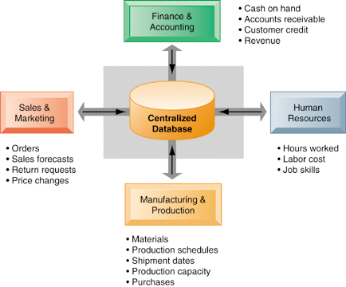
How ERP Systems Work
Enterprise systems feature a set of integrated software modules and a central database
Notes:
This graphic illustrates the function of enterprise software to integrate and share data between the different business functions.
27

Slide 28
Enterprise Resource Planning System
ERP is a centralized database application
Can be used to run an entire corporate enterprise
Shares information across between all entities
Implements the rules of all associated Business Processes
Best for structured processes
Best practices built in!
Existing process replaced
Is ERP process better?
Loss of differentiation
Not well suited for unstructured Business processes

Slide 29
Business Value of Enterprise Systems
Increase operational efficiency
Provide firmwide information to support decision making
Enable rapid responses to customer requests for information or products
Include analytical tools to evaluate overall organizational performance
Notes:
This slide discusses the business values of enterprise systems. What does it mean for the firm that enterprise systems enforce the use of common standardized definitions and formats for data by the entire organization.?
29

Slide 30
Business Process Management
Intentional effort to plan, document, implement, and distribute an organization’s business processes with IT
Best processes to manage:
Include employees from multiple departments
Require decisions that cannot be easily automated
Processes that change based on circumstances
Key Benefits of BPM:
Empowering Employees to make limited decisions
Built-in reporting provides feedback to organization
Enforces Best Practices and Consistency for a process

Slide 31
Business Process Reengineering
Automating a bad process doesn’t improve it
Develop new processes that take advantage of new technologies and concepts
BPR is fully understanding goals of a process and redesigning it to improve productivity and quality
Organize around outcomes, not tasks
Instead of repeating one step in the process over and over, the person stays involved in the process from start to end
When one department of organization creates information it should be processed by that same department
Centralize geographically dispersed resources (IT, HR, Billing)
Link parallel activities instead of integrating their results
Decisions points in workflow and build controls into process
Avoid data redundancy, capture data once, at the source

Slide 32
IT’s Six Strategic Business Objectives
Operational excellence:
Improvement of efficiency to improve profitability
Walmart’s RetailLink links suppliers to stores
New products, services, and business models:
Enabling tool for new products and services Example: Apple’s iPod, iTunes, iPhone, iPad
Business model: describes how company produces, delivers, and sells to create wealth
Customer and supplier intimacy:
Serving customers well leads to customers returning, which raises revenues and profits
Example: High-end hotels use computers to track customer preferences and customize environment
Intimacy with suppliers allows them to provide vital inputs Just-In-Time, which lowers costs
Notes:
32
Wal-Mart is the most efficient retailer in the industry and exemplifies operational excellence. You could ask students to name other businesses that they believe to exhibit a high level of operational excellence. Do customers perceive operational excellence? Does it make a difference for customer purchasing? What Web sites strike students as really excellent in terms of customer service? If you have a podium computer, you might want to visit the Wal-Mart site and the Amazon site to compare them in terms of ease of use. Walmart $28/sqft Target $23/sqft average $12/sqft
You could ask students to name other new products or business models that they’ve encountered and how they might relate to new information systems or new technology. One way to encourage participation is ask students to help you list on the blackboard some really interesting recent digital product innovations. Discussing “green technologies” like wind, solar, and hybrid vehicles is always fun. In this context, what role will IT be playing in the development of these technologies?

Slide 33
IT’s Six Strategic Business Objectives
Improved decision making with DSS
Without accurate information managers must use forecasts, best guesses, luck
Leads to overproduction and underproduction of goods
Poor response times, raise costs, lose customers
Competitive advantage
Delivering better performance
Charging less for superior products
Rapid response to customers and suppliers
Survival
Industry-level changes example: ATM’s and ACH
Governmental regulations requirements examples
Toxic Substances Control Act – 30 year records
Sarbanes-Oxley Act – 5 year accounting records for audit
Notes:
33
You could ask students what types of companies might rely more on customer and supplier intimacy more than others and which companies they feel have served them exceptionally well. Ask the students to identify online sites that achieve a high degree of customer intimacy. Sites to visit would include NetFlix, Amazon, and other sites which have recommender systems to suggest purchase ideas to consumers.
You could ask students if they have ever been recipients of exceptional service from a company made possible by improved decision-making and whether or not information systems contributed to that level of service. For example, perhaps they had a power outage and it took a very short (or very long) time for the company to correct the error.

Slide 34
Total Quality Management
ISO 9000 and 9001 defines quality standards
Corporate certification describes that they are managing business processes in an effective way
Dr Demming TQM 1 2 3 in Japan 1970’s in USA 1980’s
Deming's concepts based on statistical process control
Deming's Seven Deadly Diseases of Management
Lack of constancy of purpose
Management by use only of data, with little consideration of data that are unknown or unknowable
Evaluation of performance, merit rating, or annual review
Emphasis on short-term profits
Mobility of management; job hopping
Excessive costs of liability
Excessive medical costs
Deming's 14 Points for Management

Slide 35
Videos to View
Supply Chain? https://youtu.be/Mi1QBxVjZAw
Business Processes https://youtu.be/JUInjQvzIkE
Document MS https://youtu.be/-1udkX8VCTc
ERP https://youtu.be/6qys-562kp4
BPM https://youtu.be/iI6T3-7JxdU
BPR https://youtu.be/ee8iGNfem50
Demming - Part 1 https://youtu.be/GHvnIm9UEoQ
Demming - Part 2 https://youtu.be/mKFGj8sK5R8
Demming - Part 3 https://youtu.be/6WeTaLRb-Bs
https://deming.org/explore/seven-deadly-diseases
https://deming.org/explore/fourteen-points

